Slide 1
Auto Playing Flappy Bird
Name:Pranjal Pandey
Roll No:635

Slide 2
Introduction
Training an AI(Bird) to play the Flappy Bird Game using the Genetic Algorithm and Neuro evolution.
A genetic algorithm is a search heuristic that is inspired by Charles Darwin’s theory of natural evolution. This algorithm reflects the process of natural selection where the fittest individuals are selected for reproduction in order to produce offspring of the next generation.

Slide 3
Motivation
Flappy bird has always been criticized for being insanely irritating, difficult and frustrating game.
Later, the creators had to remove it from app store due to its frustratingly addictive nature.
So, I wanted to build an AI that would train itself to such a level that it would outperform humans and the game itself.

Slide 4
Objective
Using the Genetic algorithm and Reinforcement learning, this project trains the AI(bird) to automatically jump over the pipes(obstacles) and outperform the game.

Slide 5
Why Genetic Algorithm?
Does not require any derivative information (which may not be available for many real-world problems).
Provides a list of “good” solutions and not just a single solution.
Always gets an answer to the problem, which gets better over the time.

Slide 6
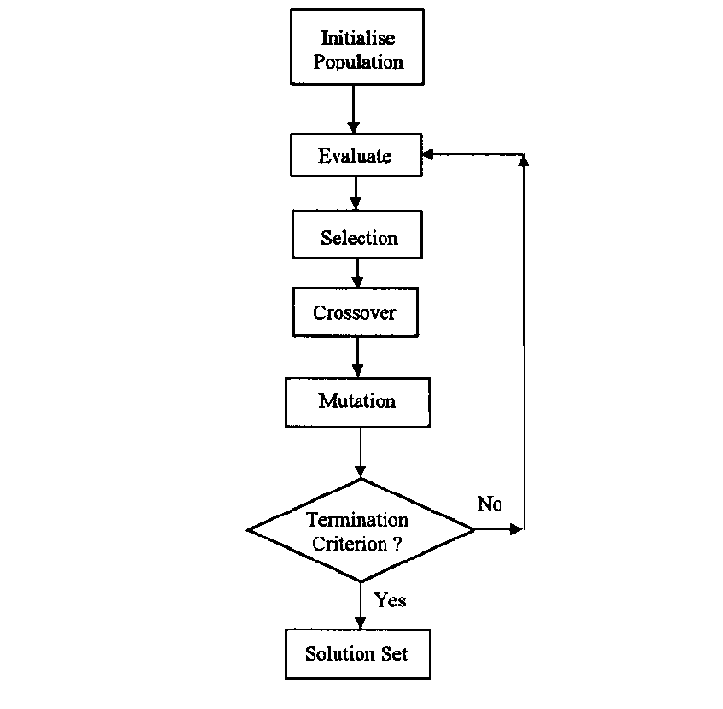
System Architecture and Design

Slide 7
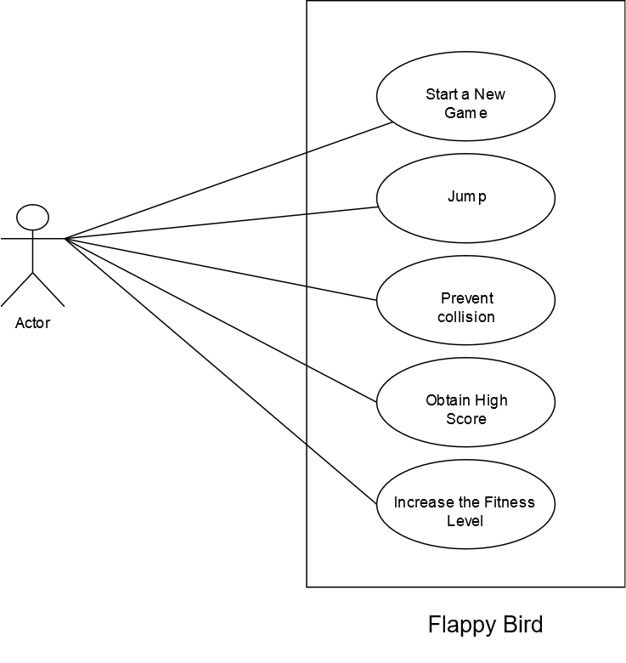
Use Case Diagram

Slide 8
Limitations
Requires many generation to obtain a fit population, hence time consuming.
Cannot predict the exact fitness of the bird at any given time.

Slide 9
Project Demo

